Slide 1
Raft Introduction
Dang Zhonghua
2019-05-31

Slide 2
Raft is one kind of consensus algorithm which means in 2f+1 server cluster, it can allow at most f server failure concurrently. This algorithm is used to reliable system/high availability.
Raft is easy-understandable version of (Multi-) Paxos
Paxos series algorithm use the mode of “Replicated State Machine”: One set of servers, if all of these servers’ state is the identical initially, then apply identical operation in the same order, all servers will be reach the same state.
Replicate State Machine is used to solve various fault tolerance in distribute system.
Replicate State Machines are always implemented by Replicated log this is Raft and Paxos Usage: to ensure that every log eventually contains the same requests in the same order,

Slide 3
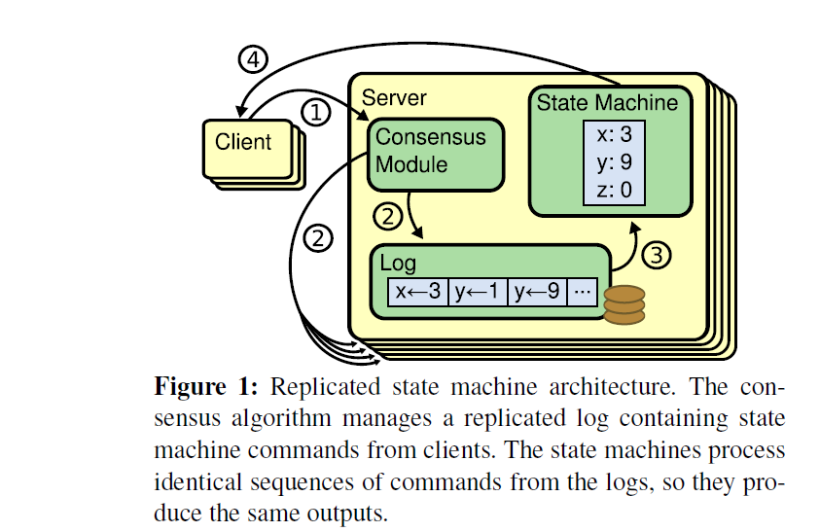

Slide 4
Consensus Algorithm Properties
Ensure Safety
Availability (liveness)
At extreme case, failure can ONLY effect liveness, NOT the consistency.

Slide 5
The essential of Paxos
Paxos first defines a protocol capable of reaching agreement on a single decision, such as a single replicated log entry
Paxos ensure safety and liveness.

Slide 6
The subproblems that raft solved
Leader election: a new leader MUST be chosen when an existing leader fail
Raft use leader to simply consensus algorithm understandability and simply data flow
Raft use leader to accept client request and decide the log entries and command other servers to handle log entries.
Log Replication: The leader MUST accept log entries from client and REPLICATE them across the cluster, forcing the log to agree with its own.
Safety: ensure the safety across servers: if one server apply log entries into state machine in particular log, then other servers must the log entries in the same order. This need help of leader election.

